Slide 1
Advocacy 101

Slide 2
Background and History
School Board Member for Clarkston Community Schools (Michigan)
President – Michigan Association of School Boards
Two Time World Chairman’s Award-Winning Mentor (FRC 27 and FRC 1816)
Current Judge and Judge Advisor for FIRST
Founder of FIRST National Advocacy Conference in Washington, DC
Founder and Treasurer of the Student Association for STEM Advocacy (SASA)
Advocacy History
Started with Michigan Department of Education and State Legislature
Turned attention to Washington, DC in 2009 with student trip Started inviting other teams Turned into NAC officially in 2014
SASA started in late 2019 Growth in State Advocacy Conferences
Notes:
Advocacy 101

Slide 3
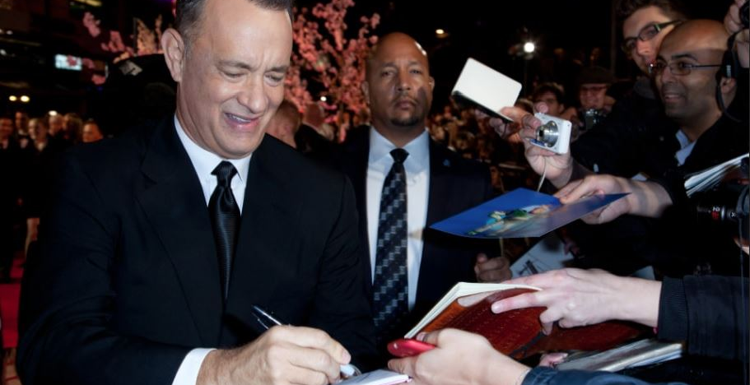
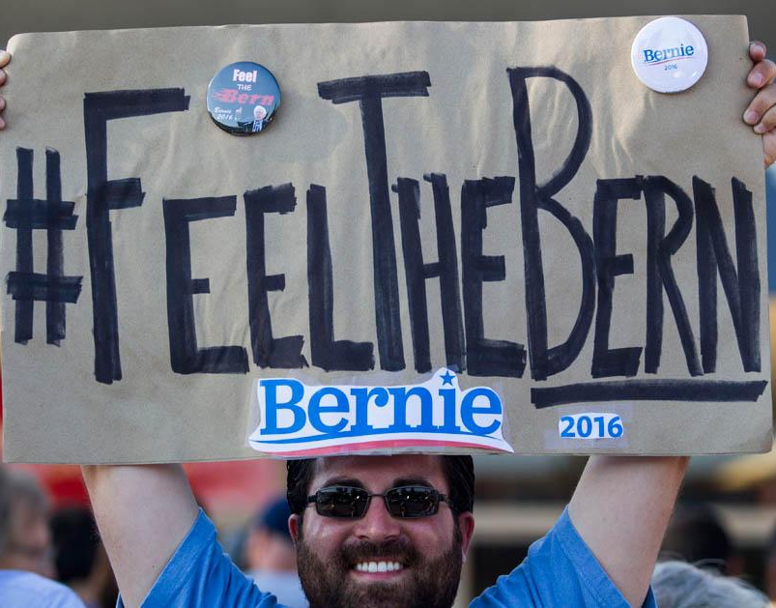
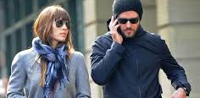
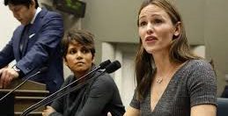
write
call
visit
Introductions
Who Are you
Where are you from (state, city, and team)
One thing you want to get out of this conference
Notes:
Our focus is on relationships (amongst us and with policymakers)
Ways to get involved: Letters, Group or Individual Trips, Forums, Personal meetings, Annual Advocacy Bootcamp and Training Sessions

Slide 4
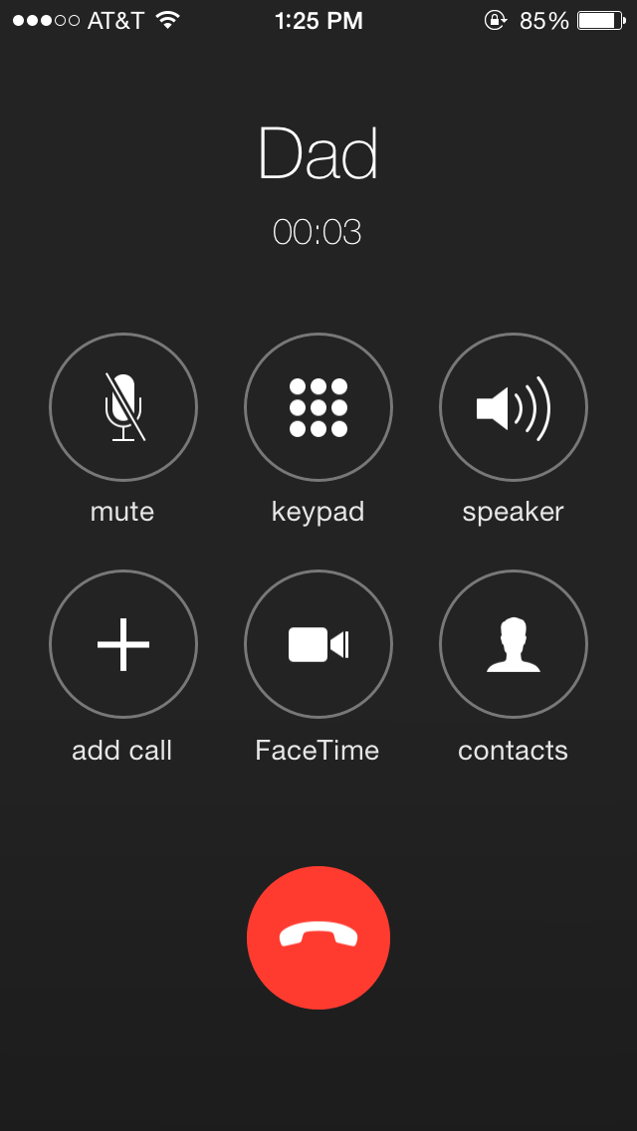
You can advocate for anyone or anything
Rep. Tedder
Engaged, educated citizenry is a cornerstone of a productive and effective democracy.
Examples
Graduation requirements should contain a CTE experience
State funding should continue for REC Foundation programs
Every student should be exposed to STEM before graduation

Slide 5
How and where do I start?

Slide 6
Pick a Target
Form a Relationship
Settle In
Notes:
How and where do you start?
Pick a target
Start to form a relationship
Long game over a very long period of time

Slide 7
Who do you go to, and how?
Start Local
(school, township, city, county, state, nation…)
Write
Call
Visit
Notes:
Is there a place here to get people to share if and how they’ve interacted with legislators in the past and what the outcome was -- changed a vote, ignored me, was rude, etc.? It might be a good lead in to the next slide about relationships. - KH

Slide 8
“Relationships, Relationships, Relationships.”
(Once again, it's all about...)

Slide 9
Notes:
On next steps -- I wonder if we should be more prescriptive here or in the bootcamp about HOW to talk to an elected official … i.e. say 3 things: 1. I’m asking you to support/oppose XXX … 2. Why … 3. Specific anecdote/example/impact. I think people might need a guide for how to write an email, what to say on the phone or in person, etc. Not sure where it fits -- KH

Slide 10
To affect a process, you have to know the process!

Slide 11
Who do you need to know?
Knowing the rules of the game and the players allow you to build relationships.
Start Local
Your Local School District: Teacher, Principal, Superintendent, Elected School Board Members
Your Local Township/City: Department Directors, Elected Township Board (Supervisor, Treasurer, Clerk, Trustees) or City Council (Mayor, Council Members), Zoning Board of Appeals
Your Local County: County Executive and Key Staff Leaders, County Clerk, Water Resource Commissioner, Sheriff, Local County Commissioners, Road Commission of Oakland County
State & National Decision-Makers
Your State: Governor, Lt. Governor, Secretary of State, Attorney General, Chief State School Officer, Assembly (House and Senate)
United States of America: President, Vice President, Cabinet Level Positions (Secretary of Education, Secretary of Agriculture, Interior, EPA, Attorney General), United States House of Representatives (435 Members), United States Senate (100 Members)

Slide 12
Student Association for STEM Advocacy
Sponsor of NAC
Advocacy Association
Membership Opportunities
Individual Membership ($25/year)
Team Membership ($200/year)
Corporate Membership ($500/year)
Benefits
Monthly Update
NAC Registration Discounts
Legislative Action Alerts
Website: mysasa.org Twitter: @SASAdvocacy Facebook: @SASAdvocacy

Slide 13
The National Advocacy Conference presented by The Student Association for STEM Advocacy
In person! June 25th to June 27th Washington, D.C.
Registration now open at www.mysasa.org
Contact us with any questions! Steve Hyer staff@mysasa.org
Notes:
Welcome: Introduce yourself, Tell us about your kids, What do you hope we can deliver in this group?
Introduction: History of Parent Trips, Possible testimonials from 2 to 3 participants, Outcomes (Relationships and Engagement and Future Action), Desire to engage our entire community
Clarkston Champions – What is it? Collection of individuals who want to impact positive change for our kids and our community (local, state, nation)

Slide 14
Questions

