Slide 1
Effective Meetings with Your Elected Officials
States of New England Advocacy Conference

Slide 2
“Relationships, Relationships, Relationships.”
Advocacy is all about…

Slide 3
Before Your Meeting

Slide 4
Do Your Homework
Do their kids attend your school?
What Committees are they on?
Do/did they have a job?
Legislation they’ve introduced/supported?
Make a leave behind

Slide 5
Goals
Develop a relationship
Make them fans of robotics
ASK (optional)

Slide 6
Preparing for a Meeting
DO
Assign roles
Facilitator
Someone to field questions
Have an order of issues and talking points
Make an ASK
Be Concise
PRACTICE (including technology)
AVOID
Talking about campaigns / fundraising / elections
Contradicting each other
Falling into traps

Slide 7
During the Meeting

Slide 8
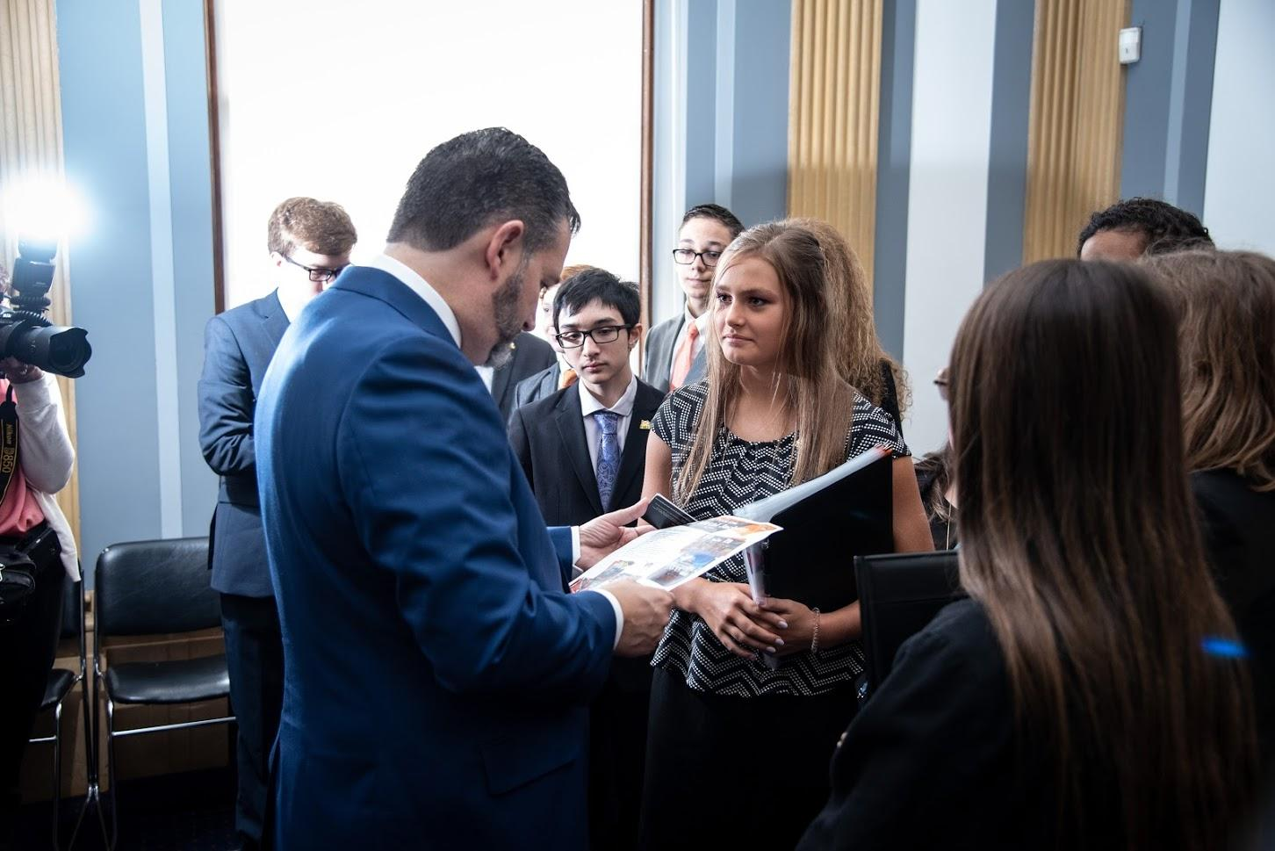
A Meeting
Stick to the outline/stay on topic
BE IMPRESSIVE
Always take notes
Connect the dots
Never answer a question you do not know the answer to
Bring a leave behind
Share your excitement and passion for robotics (possibly with data)
Be a resource for them

Slide 9
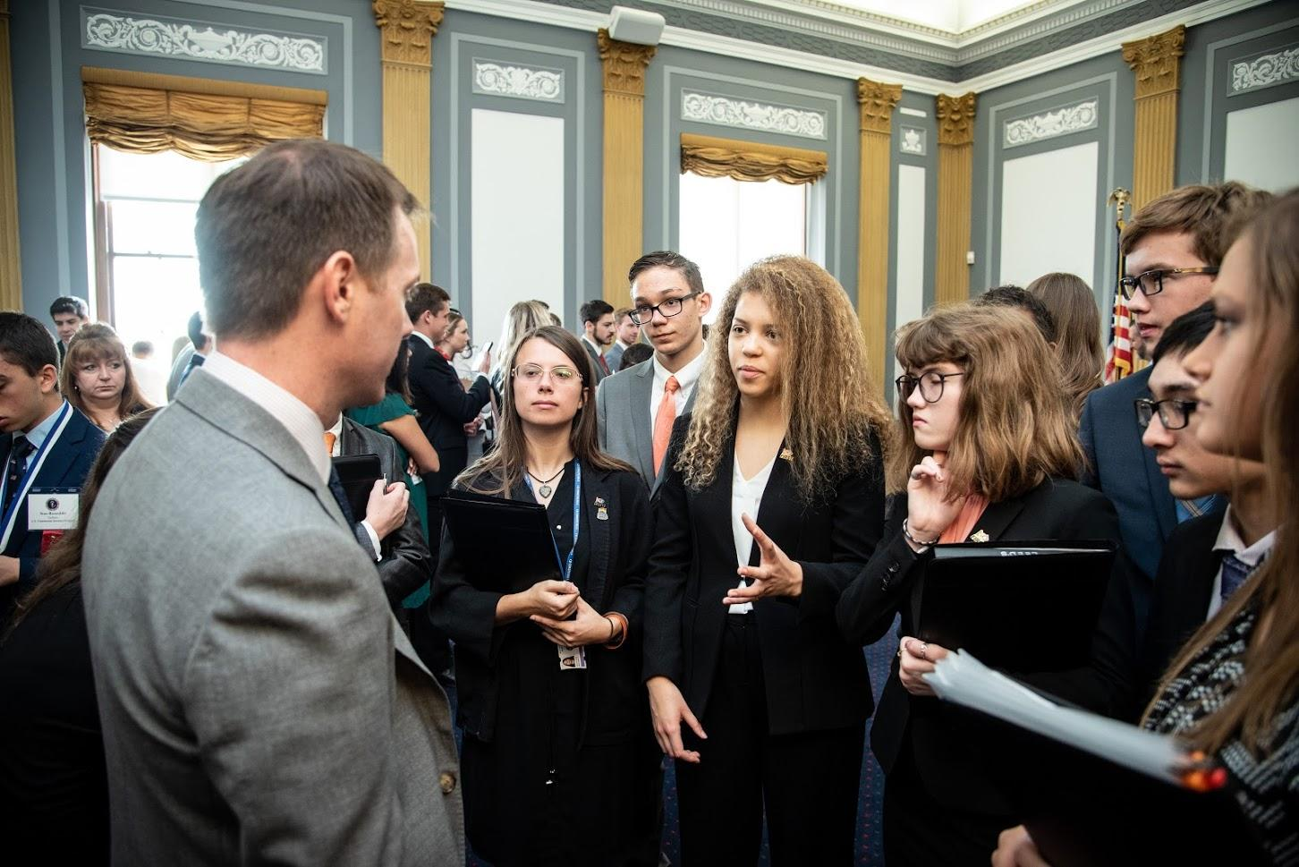
Staff Level Meetings

Slide 10
After Your Meeting

Slide 11
Follow Up
One person follows up
Don’t become pen pals
Make them remember you

Slide 12
Meeting on Zoom
Physical/Virtual Backgrounds
Facilitator monitoring participants on the meeting
Order of introductions
Video off if not speaking in the meeting
Delay in response makes conversation hard
One person per camera (not in same physical room)
Follow up/Leave Behinds
Tech Savvy?
Length of meeting
What to wear
Meeting in your build space
Conversation vs. Presentation
Pausing for Interaction

Slide 13
The Ask

Slide 14
What other States are Asking for
Michigan
Section 99h in the School Aid Budget
Allows state funds to be allocated directly for robotics programs
New York
Bills A1219 and S9411
Established and Appropriates funds for a grant program to fund high school participation in competitions related to STEM fields
California
Increase/maintain funding for the Expanded Learning Opportunities program.
Wisconsin
Increase the WI Robotics League Participation Grant from $500,000 a year to $750,000

Slide 15
The Ask
Massachusetts
Ask to cosponsor HD.2136 and SD.1182
New Hampshire
Thank them for their continued support and funding

Slide 16
The Data
Longitudinal Study from Brandeis University based on 10 years of Data say FIRST Students:
2.2x more likely to be interested in STEM
2.1x more likely to show higher interest in STEM careers
1.9x more likely to show higher involvement in STEM activity
1.8x more likely to score higher in understanding of STEM
81% of FIRST Alumni Declare Majors in STEM
83% of FIRST Alumni have Confidence to Take Leadership Roles
2x more likely to major in engineering or science (41% in engineering)
87% more interested in doing well in school
87% plan to take a more challenging math or science course
89% more interested in going to college
93% increase conflict resolution skills, 95% time management skills, 98% problem solving skills, 76% communication skills
75%+ of Alumni are in STEM field as a student or professional
Major corporations supporting FIRST and teams (examples of corporate support for your team)
FIRST sponsors include more than 200 of the Fortune 500 companies

Slide 17
The National Advocacy Conference presented by The Student Association for STEM Advocacy
In person! June 25th to June 27th Washington, D.C.
Registration now open at www.mysasa.org
Contact us with any questions! Steve Hyer staff@mysasa.org
Notes:
Welcome: Introduce yourself, Tell us about your kids, What do you hope we can deliver in this group?
Introduction: History of Parent Trips, Possible testimonials from 2 to 3 participants, Outcomes (Relationships and Engagement and Future Action), Desire to engage our entire community
Clarkston Champions – What is it? Collection of individuals who want to impact positive change for our kids and our community (local, state, nation)

Slide 18
Questions

