Slide 1
School funding in Massachusetts:
How it works, how it doesn’t,
how it’s spent, and who decides

Slide 2
“Old Deluder Satan” law of 1647
“That every Township in this Jurisdiction, after the Lord hath increased them to the number of fifty Housholders, shall then forthwith appoint one within their town to teach all such children as shall resort to him to write and read, whose wages shall be paid either by the Parents or Masters of such children, or by the Inhabitants in general, by way of supply, as the major part of those that order the prudentials of the Town shall appoint.”
This Photo by Unknown Author is licensed under CC BY-SA

Slide 3
What happens when education is locally funded?
Those that have fund more
Those that don’t have fund less
Plus communities with fewer resources
often have greater needs.

Slide 4
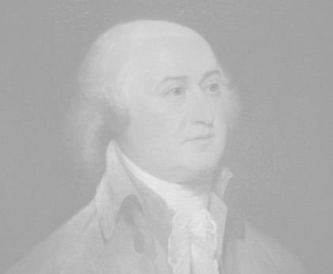
Constitution of the Commonwealth of Massachusetts 1780
“Wisdom and knowledge, as well as virtue, diffused generally among the body of the people, being necessary for the preservation of their rights and liberties; and as these depend on spreading the opportunities and advantages of education in the various parts of the country, and among the different orders of the people, it shall be the duty of legislatures and magistrates, in all future periods of this Commonwealth, to cherish the interests of literature and the sciences, and all seminaries of them; especially the university at Cambridge, public schools and grammar schools in the towns . . .”
it shall be the duty of legislatures and magistrates
This Photo by Unknown Author is licensed under CC BY-SA

Slide 5
McDuffy v Secretary of State Executive Office of Education 1993
“In this light, we have considered the proper meaning of the words "duty" and "cherish" found in c. 5, Section 2. What emerges from this review is that the words are not merely aspirational or hortatory, but obligatory. What emerges also is that the Commonwealth has a duty to provide an education for all its children, rich and poor, in every city and town of the Commonwealth at the public school level, and that this duty is designed not only to serve the interests of the children, but, more fundamentally, to prepare them to participate as free citizens of a free State to meet the needs and interests of a republican government, namely the Commonwealth of Massachusetts.”
The Commonwealth has a duty to provide an education for all its children, rich and poor, in every city and town of the Commonwealth
This Photo by Unknown Author is licensed under CC BY-ND

Slide 6
The state thus is faced with two questions:
How much does it cost to educate a child in Massachusetts?
Who is going to pay for it?

Slide 7
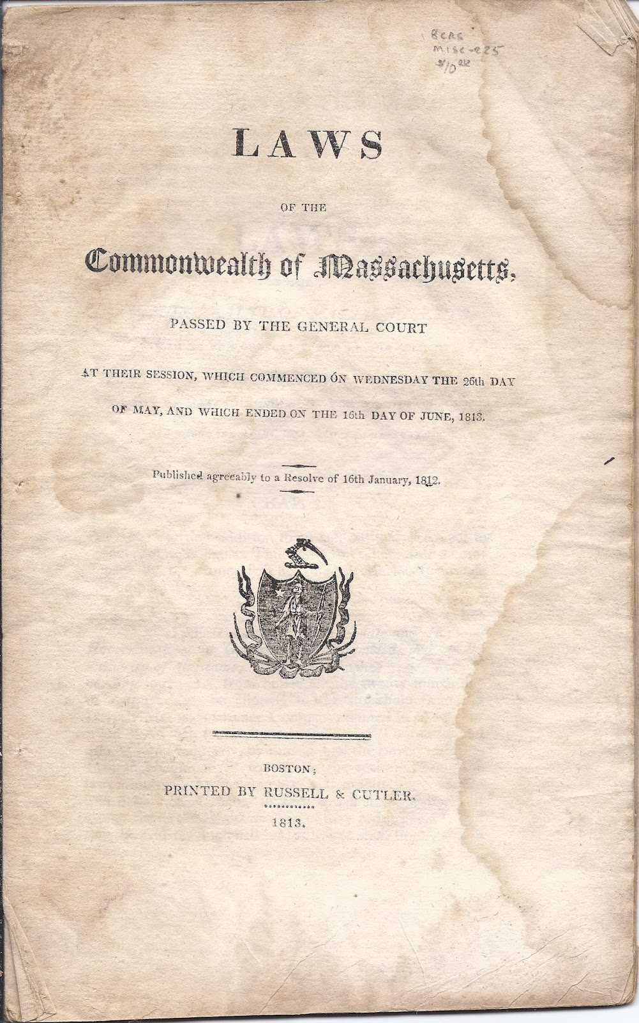
Massachusetts General Law Chapter 70, section 1
“It is the intention of the general court, subject to appropriation, to assure fair and adequate minimum per student funding for public schools in the commonwealth by defining a foundation budget and a standard of local funding effort applicable to every city and town in the commonwealth.”
This Photo by Unknown Author is licensed under CC BY-NC-ND

Slide 8
Administration
Instructional Leadership
Classroom & Specialist Teachers
PD
Other teaching services
Instructional Materials, Equipment, and Technology
Base foundation amount
Operations and
Maintenance
Pupil Services
Employee Benefits/Fixed Charges
Special education Tuition

Slide 9
the following are House 1 [Governor’s budget] rates

Slide 10
Foundation budget rates: House 1 FY24

Slide 11
English Learner increment
Low income increment
Base foundation amount

Slide 12
English learners increment: House 1 FY24

Slide 13
Low income: House 1 FY24

Slide 14
Special education: House 1 FY24

Slide 15
For example:
An elementary student
who is also an English learner
and is low income in a decile 5 district
English learner increment
PreK-5
$2,392.51
Low income increment Decile 5
$4,126.30
Base foundation amount Elementary: $8,425.49
=$14,944.30

Slide 16
Inflation rate*
NOTES: Since FY22, health insurance has a separate rate; it is 5.16% for FY24. Since FY22, the rate is capped at 4.5%; the actual rate for FY24 would be 6.1%.
*Price Deflator Index for State and Local Governments

Slide 17
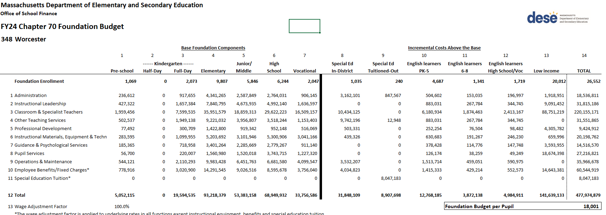

Slide 18
Foundation budget fast facts:
Districts must spend no less than 95% of this amount each year.
They can (and most do!) spend more.
This does not include all funds spent on education in a district: transportation, some rental property, a few other items are not included. Grants are not included in this amount, nor is capital spending.
This is intended as a “fair and adequate minimum.”
We are currently entering year 3 of changes due to the Student Opportunity Act, signed into law in November 2019.

Slide 19
The state thus is faced with two questions:
How much does it cost to educate a child in Massachusetts?
Who is going to pay for it?

Slide 20
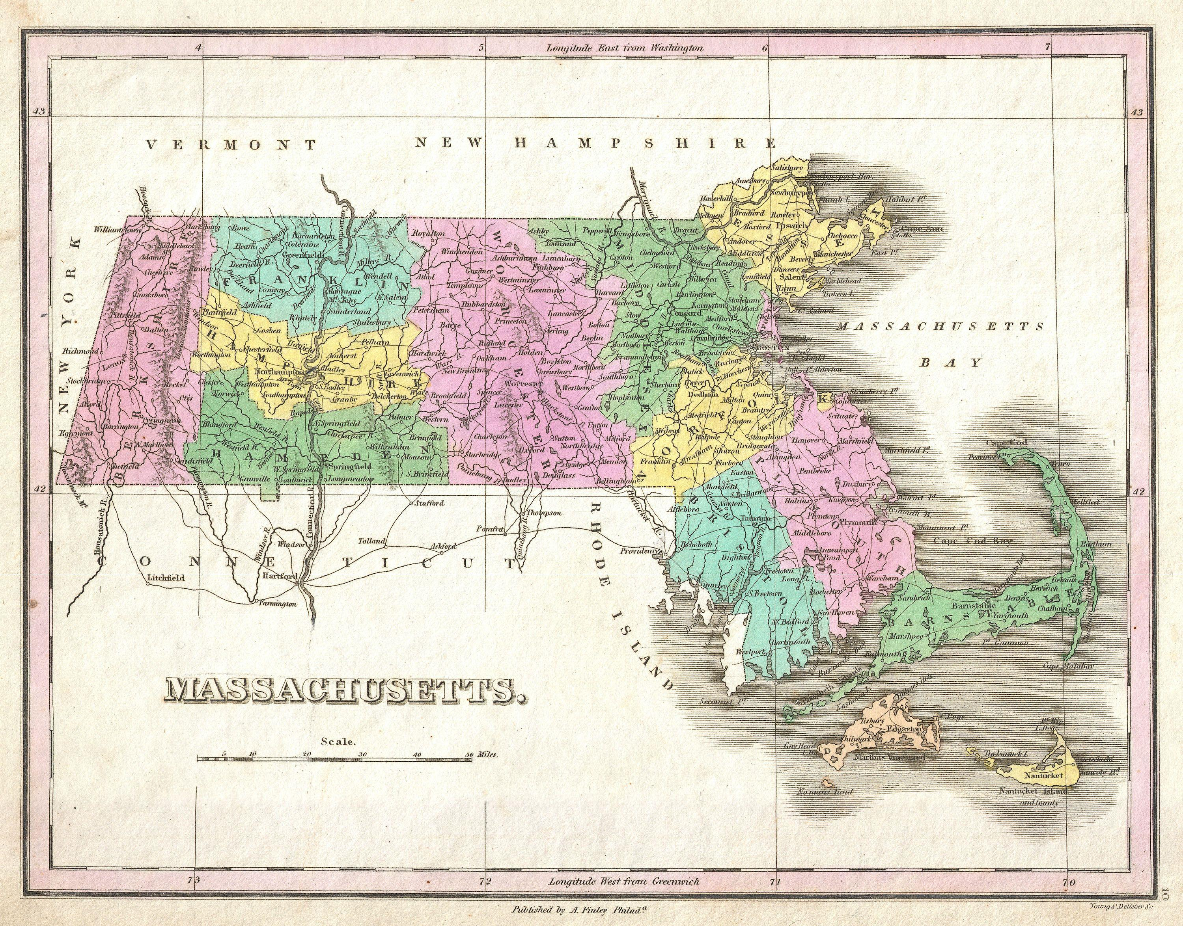
The foundation budget is intended to be funded with:
59% local funding
41% state funding

Slide 21
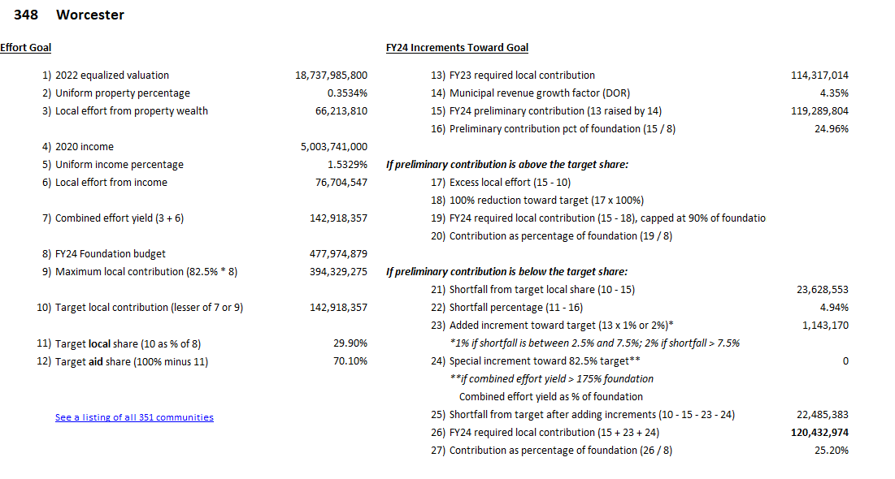

Slide 22
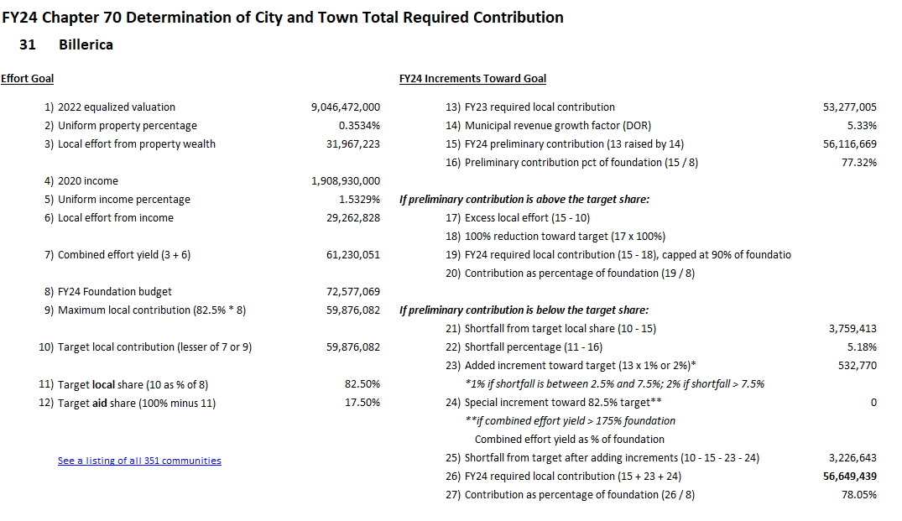

Slide 23
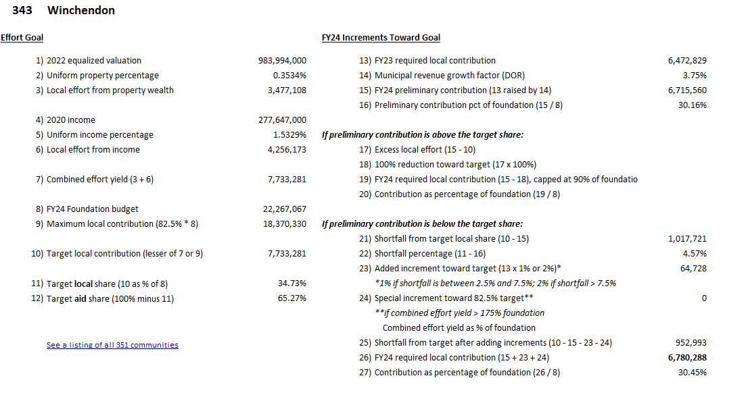

Slide 24
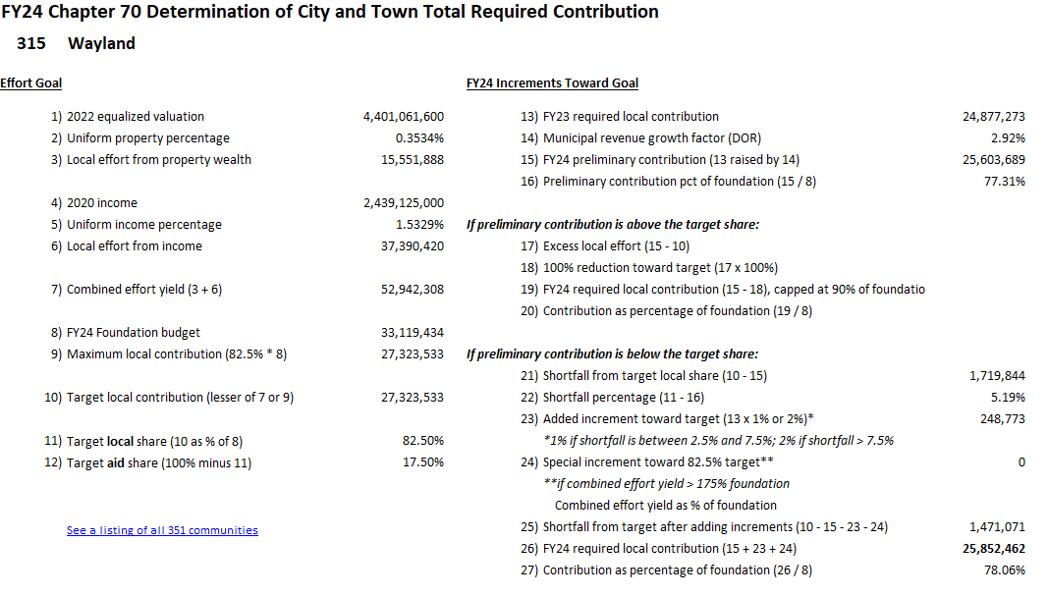

Slide 25
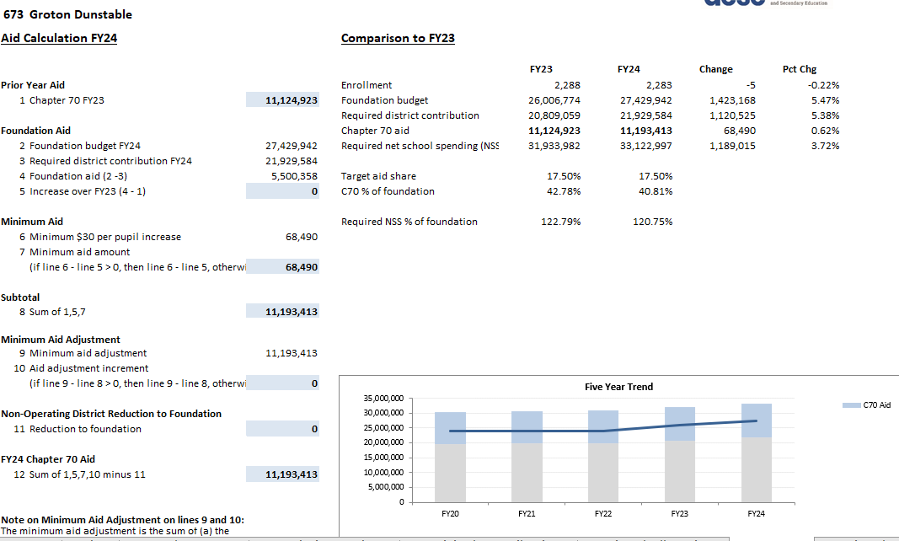

Slide 26
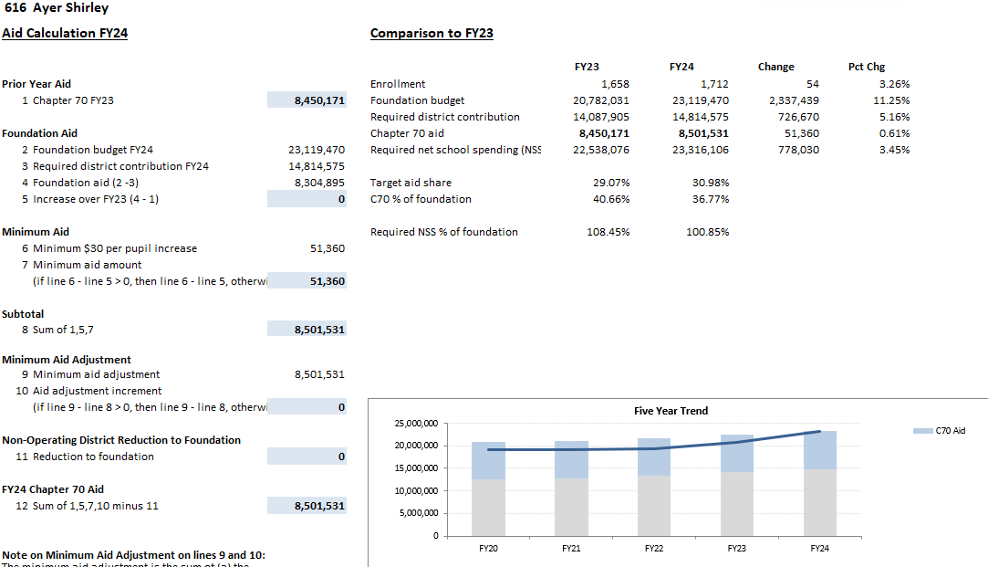

Slide 27
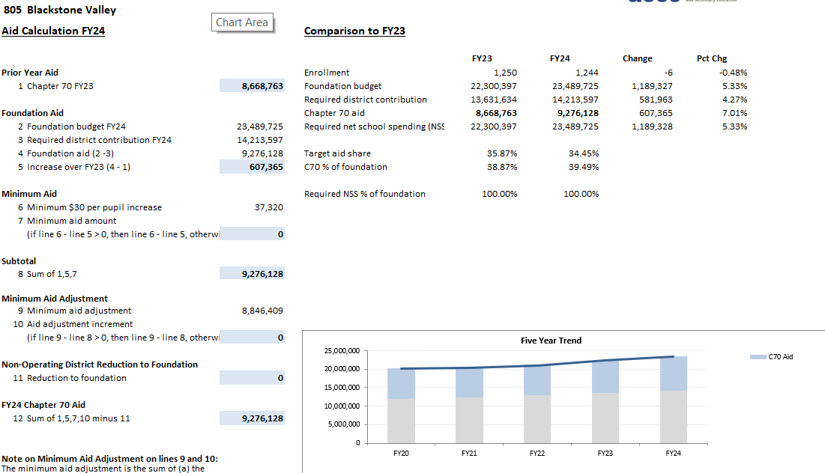

Slide 28
BUT THAT’S NOT ALL!

Slide 29
What do districts actually spend?
A look at FY21: spending over required minimum from what was budgeted
District | Foundation budget | Actual net school spending | Percentage over required
Ayer-Shirley | $16,921,239 | $29,165,721 | 72.4%
Blackstone Valley Tech | $20,447,639 | $22,622,354 | 13.5%
Billerica | $52,647,472 | $81,108,444 | 54.1%
Groton-Dunstable | $24,034,914 | $38,443,512 | 59.9%
Wayland | $28,213,341 | $50,671,302 | 79.6%
Winchendon | $15,745,626 | $17,018,499 | 8.1%
Worcester | $382,606,984 | $392,653,611 | 2.6%
Important note: this is all general fund spending

Slide 30
What do districts actually spend?
Notes: General fund spending In FY21, a number of districts remained remote for part or most of the year, allowing transportation funding to be moved to net school spending categories
A look at FY21: spending over required minimum

Slide 31
Budget cycle
Superintendent & Administrators Assess Needs/Priorities
Long term changes in enrollment and in programming should be part of your long-term budget planning process.
Warrants, quarterly reports, other updates
Budget Implemented and Monitored
Superintendent Presents Budget to School Committee
Ongoing conversations with municipal/state on resources and within district on needs
Final Budget Approved by Appropriating Authority(ies)
SC Deliberates* and Approves Budget to submit to Appropriating Authority(ies)
*Note that this must include at least one public hearing per MGL Ch.71, Sec.38N
Notes:
While local budget cycles vary, everyone’s looks more or less like this.
31

Slide 32
Budget timeline
January
April
May
June
July (?)
March this year, due to new Governor!
State:
Governor’s (H1/H2) budget
House Budget
Senate Budget
Budget!
Conference Committee
Local:
Admin proposes budget to school Committee
School Committee approves budget
Budget sent to appropriating authorities
Appropriating authorities approve
School Committee public hearing
Budget!
DIFFERS BY TOWN— Earlier for towns! Later for cities!
New fiscal year: July 1!

Slide 33
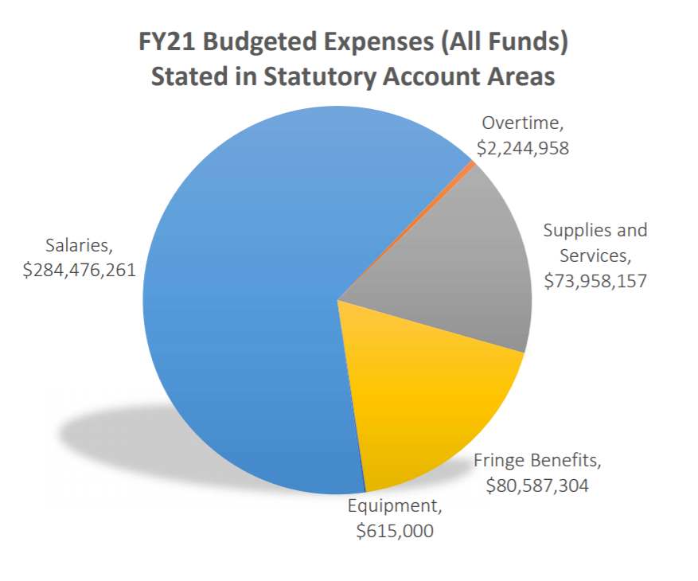
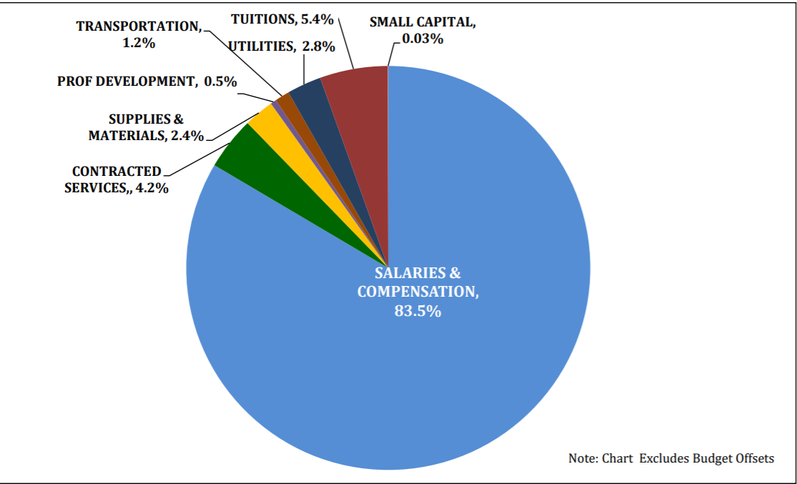
Where does the money go?
North Reading Public Schools FY21 budget $32,526,778
Worcester Public Schools
FY21 budget
$441,881,680
Notes:
Here are terms you may hear used when discussing budgetary allocation.
33

Slide 34
Who ultimately decides?
“The school committee in each city and town and each regional school district shall have the power to select and to terminate the superintendent, shall review and approve budgets for public education in the district, and shall establish educational goals and policies for the schools in the district consistent with the requirements of law and statewide goals and standards established by the board of education.”
MGL ch. 71, sec.37

Slide 35
Tracy O’Connell Novick
Worcester School Committee
Field Director: School Finance Massachusetts Association of School Committees
@tracynovick
tnovick@masc.org
508-579-5472

