Slide 1
COMMONWEALTH OF MASSACHUSETTS LEGISLATURE 101
Southern New England Advocacy Conference (SNEAC)
February 26th, 2023
Gabriel Adams-Keane
Legislative Director
Office of State Senator John C. Velis
Hampden and Hampshire District

Slide 2
Vocabulary
Amendment - Any alteration made (or proposed to be made) to a bill
Bill - a draft of a proposed law presented to the legislature
Committee – A body of members appointed to consider and make recommendations concerning disposition of bills, resolutions and other related matters
Conference Committee - A committee composed of members from the two houses specifically appointed to reconcile the differences between House and Senate versions of a bill or bills
General Court – state legislature of the Commonwealth of Massachusetts
Law - an individual rule as part of a system of law
Legislator – a member of the legislative body
Legislature - deliberative assembly with the authority to make laws for a political entity such as a country or city
Majority Party - The political party having the greatest number of members in the legislature or in either chamber
Minority Party - The political party having fewer numbers of members in the legislature or in either chamber
Testimony – spoken or written statements that something is true
Veto - Action by the governor to disapprove a measure

Slide 3
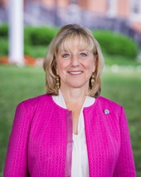
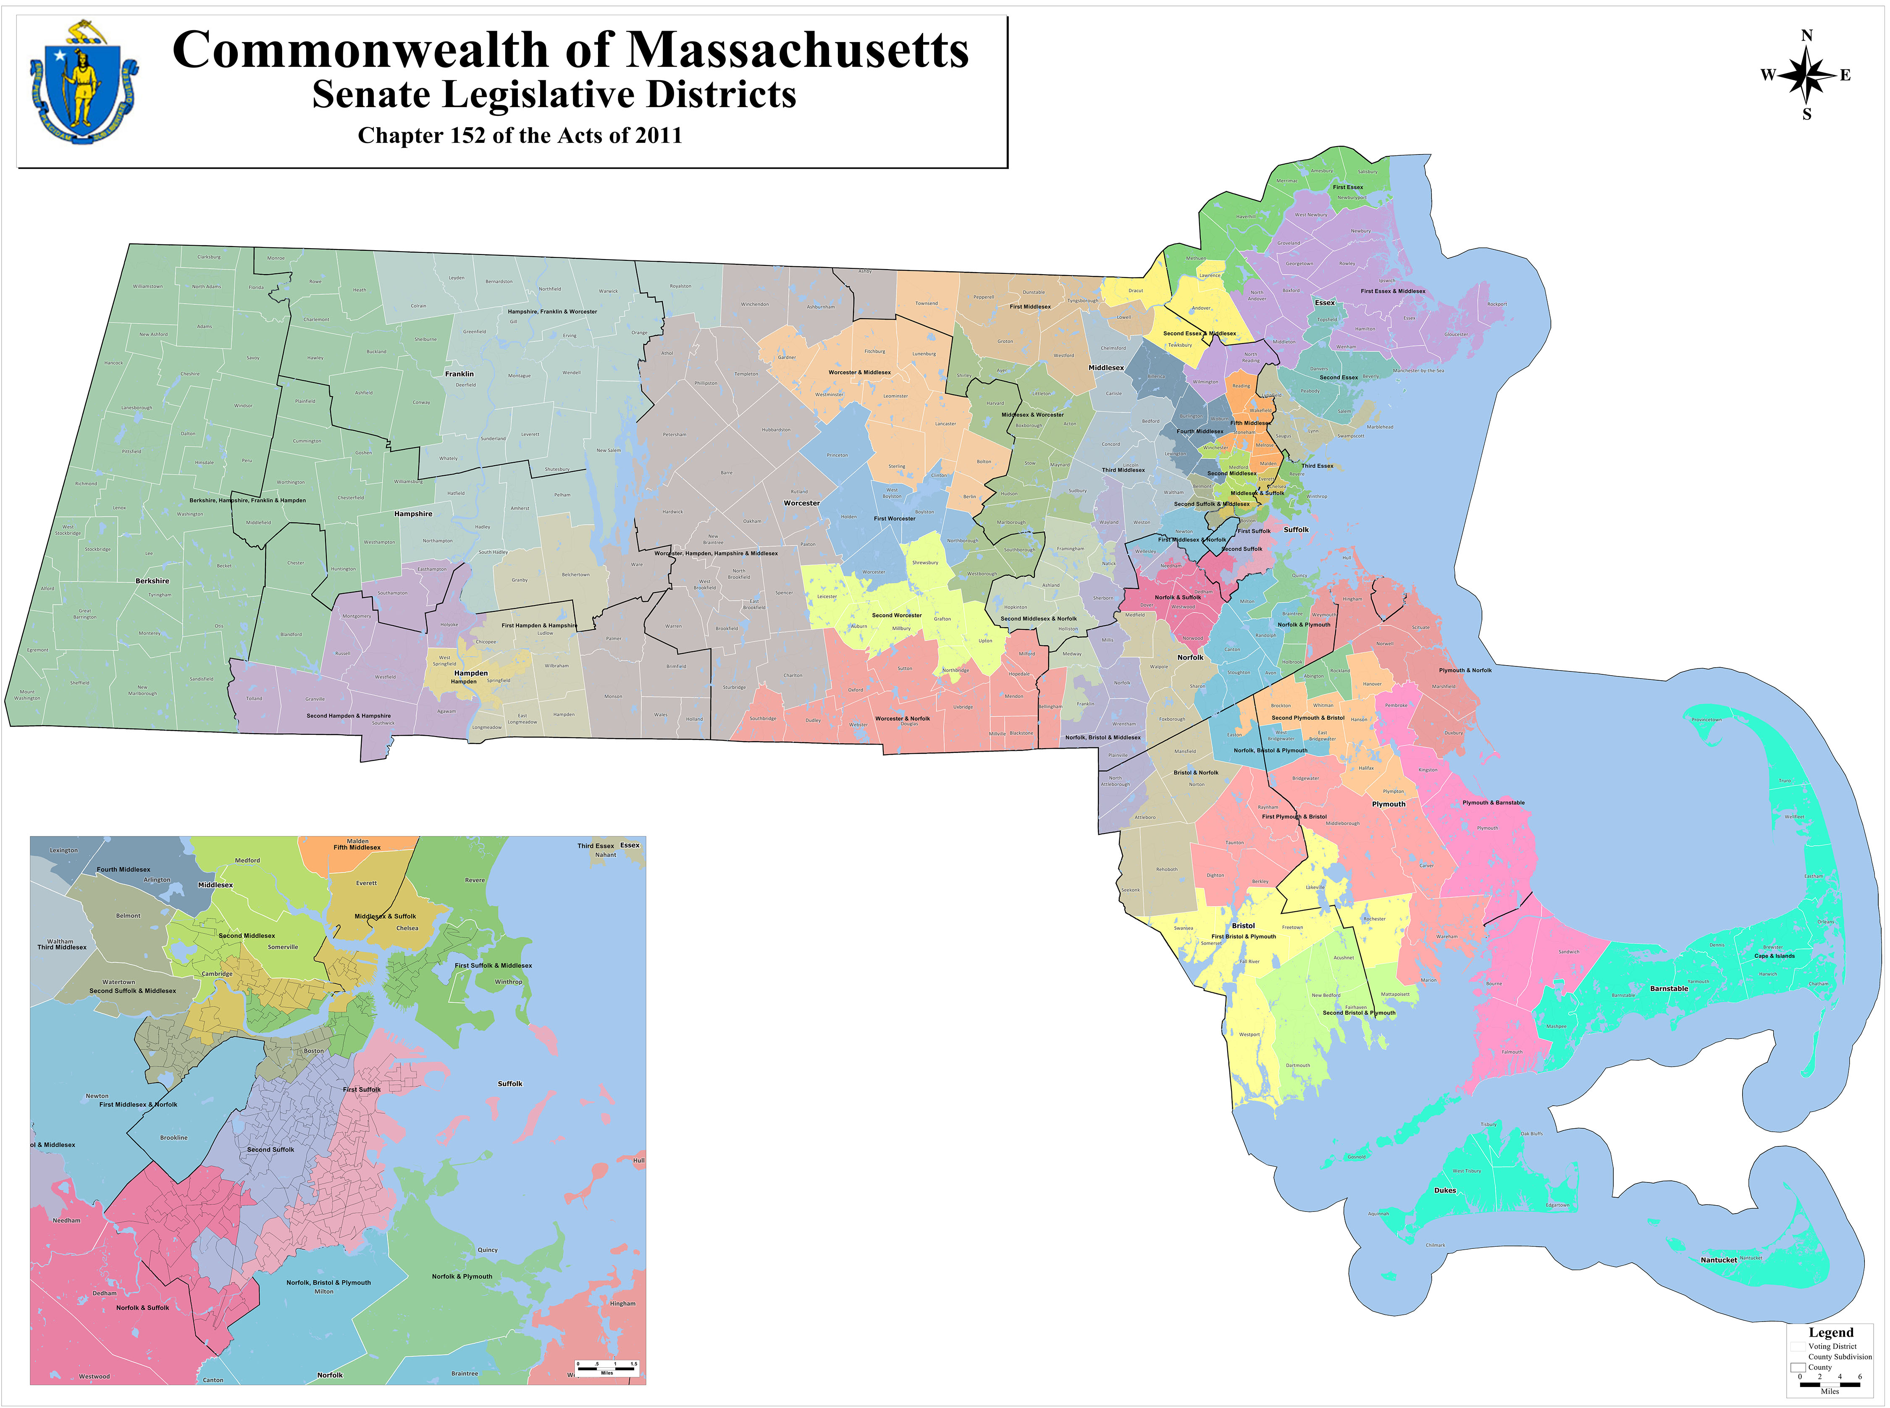
Composition of the General Court
Senate
Senate President
Sen. Karen Spilka (D-Ashland, 2nd Middlesex and Norfolk District)
40 Members
Represent about 159,000 constituents each
37 Democrats, 3 Republicans
Elected for 2 year terms

Slide 4
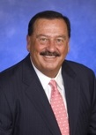
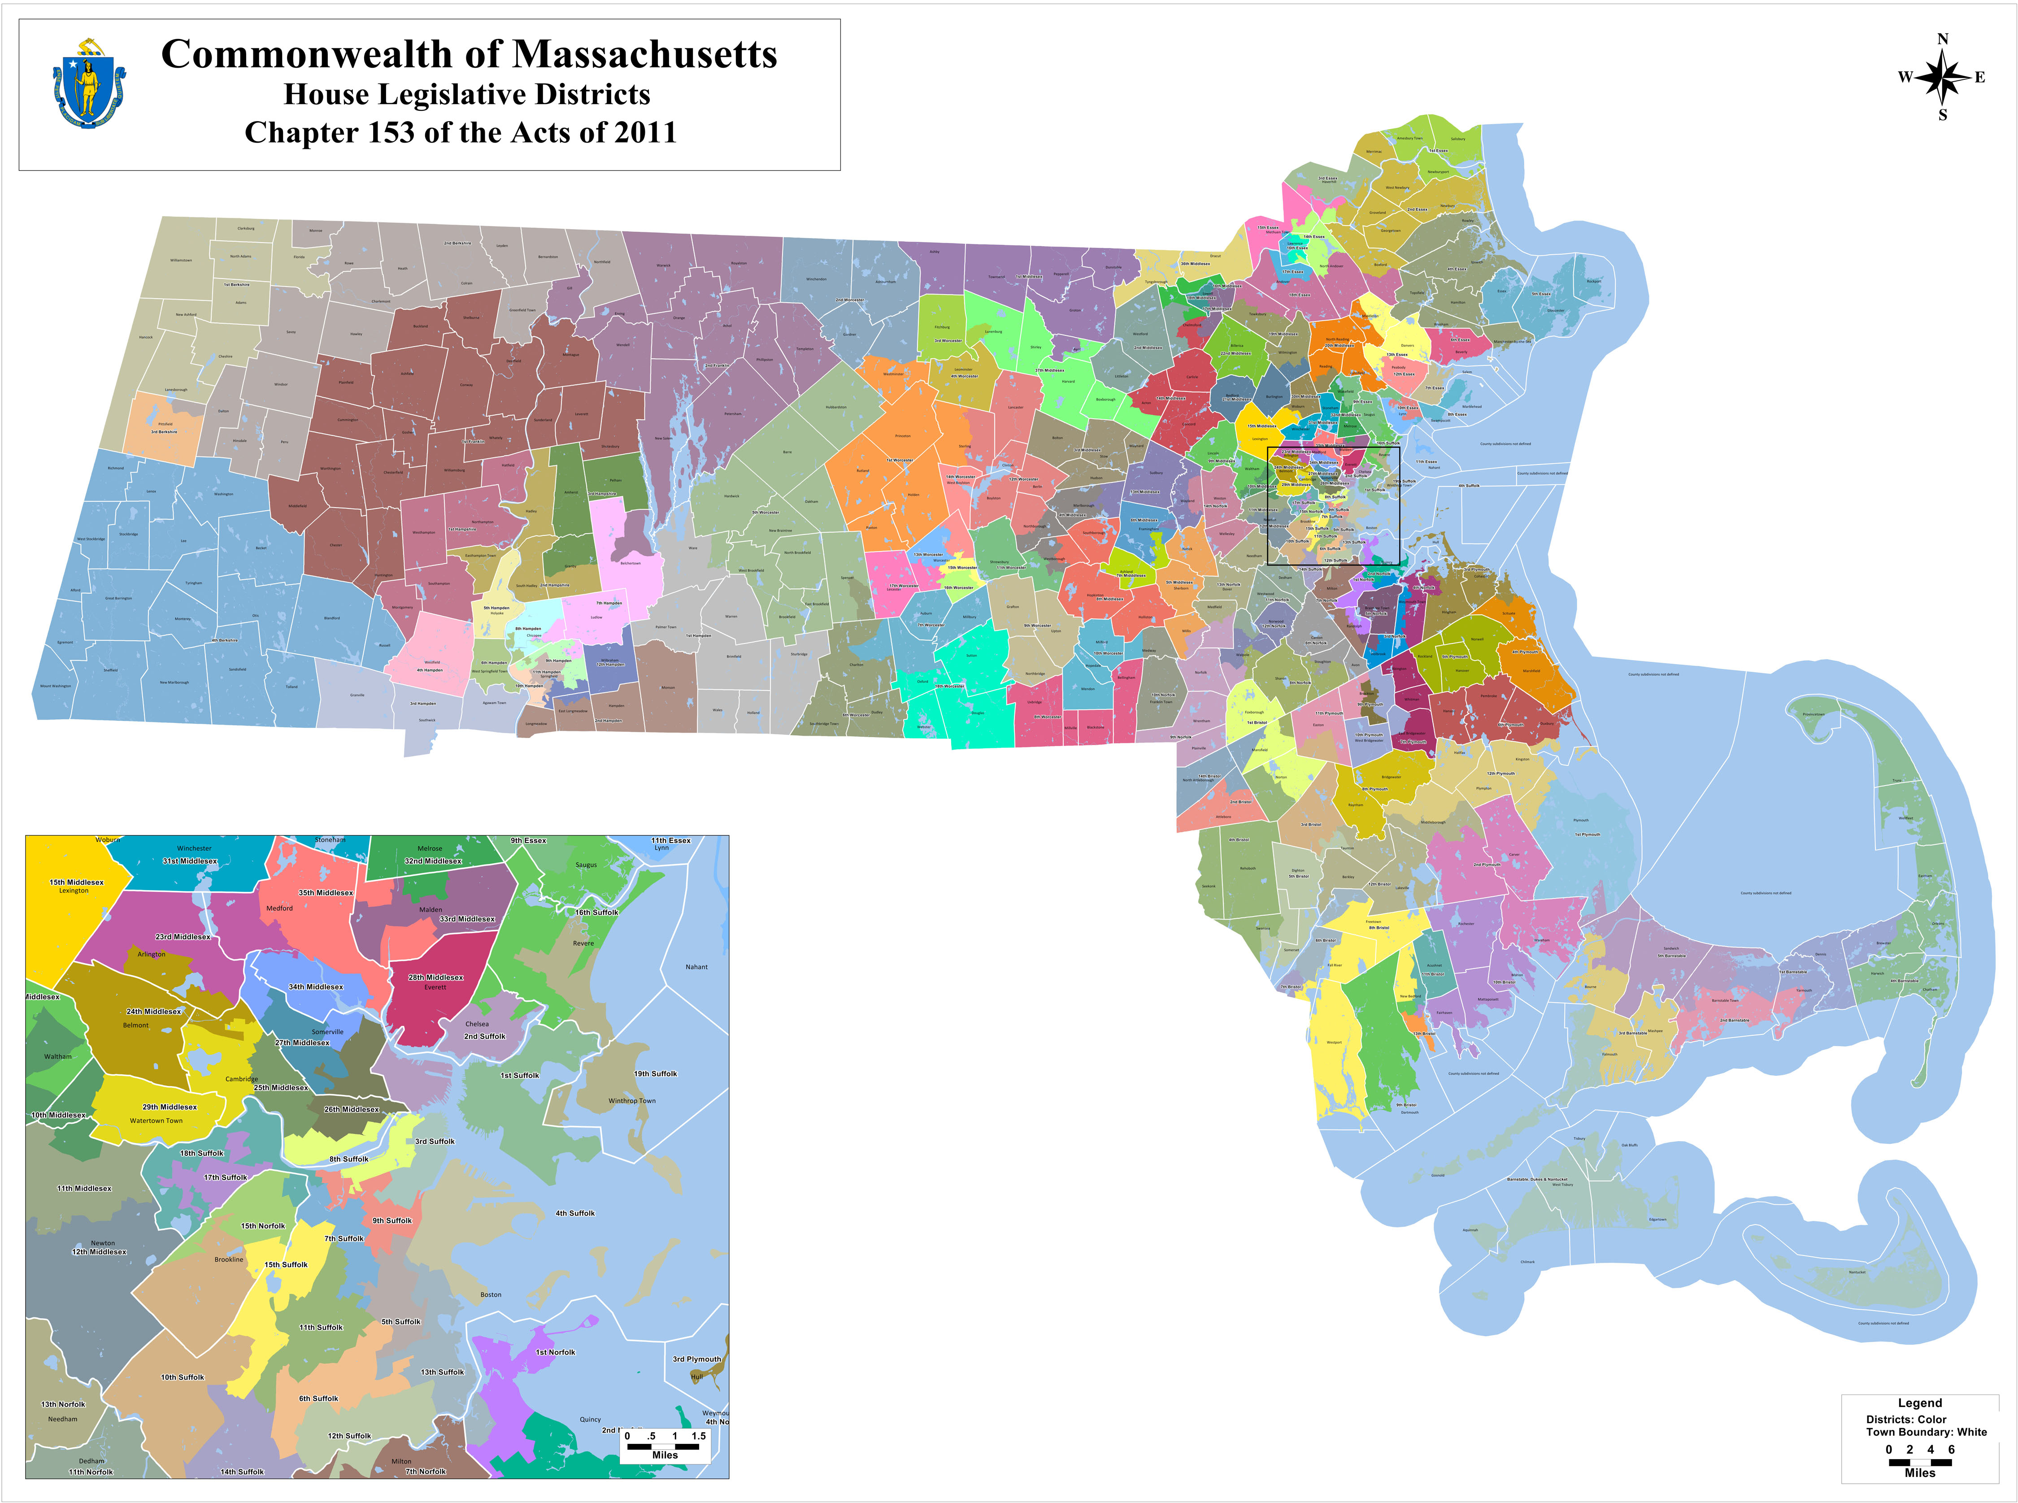
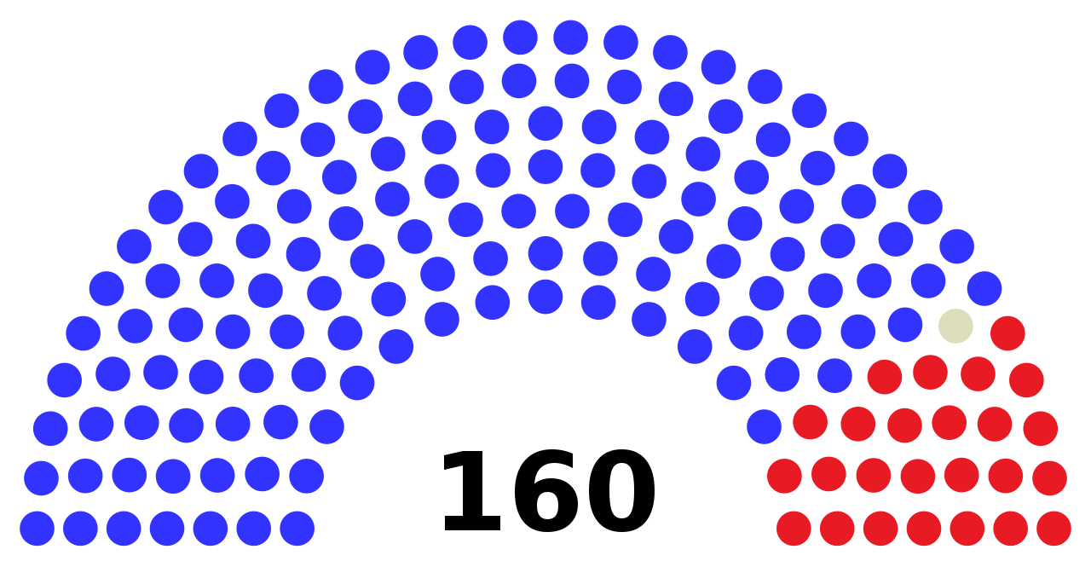
Composition of the General Court
House of Representatives
Speaker of the House
Rep. Ronald Mariano (D-Quincy, 3rd Norfolk District)
160 Members
Represent about 40,000 constituents each
134 Democrats, 25 Republicans, 1 Unenrolled
Elected for 2 year terms

Slide 5
Leadership & Committee Structure
Leadership of each branch assigns chairs and members to specific Committees charged with closely looking at Legislation
Sen. Velis, for example, is Chair of 2 committees:
Senate Chair of Mental Health, Substance Use, And Recovery
Senate Chair of Veterans and Federal Affairs
Senate Vice-Chair of Elder Affairs
Sen. Velis also sits on 4 committees: Housing, the Judiciary, Public Safety & Homeland Security, and State Administration and Regulatory Oversight

Slide 6
Role of Committee
Public Hearings
Every bill in Massachusetts is required to have a public hearing
Chance for committee to hear input and debate from public
Committees and Chairs are able to move bills along, eventually to the Floor for debate and passage, or to hold them in Committee

Slide 7
Step 1: There ought to be a law!
Bills (and ultimately laws) can originate from:
Proposals sponsored by legislators or the Governor
Recommendations of a department or agency
Recommendations of a think tank or other non-governmental organization
Members of the public
Idea
Draft
File
Cosponsorship
Hearing
Report
2nd Reading
3rd Reading (1)
3rd Reading (2)
1st Branch
2nd Branch
Concurrence
Enactment
Law

Slide 8
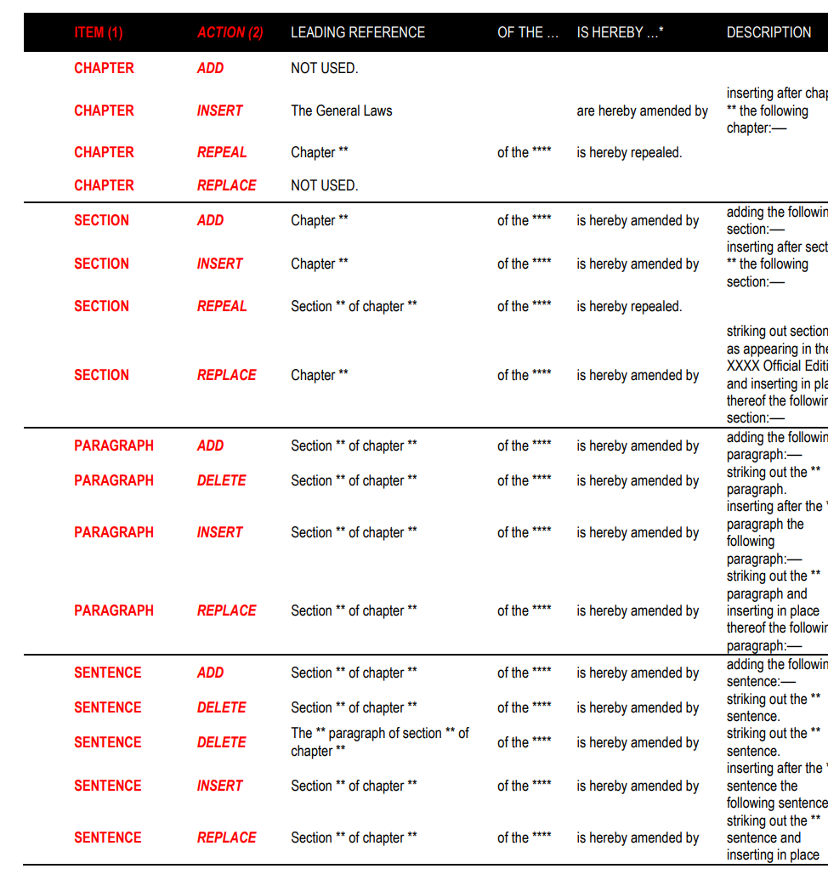
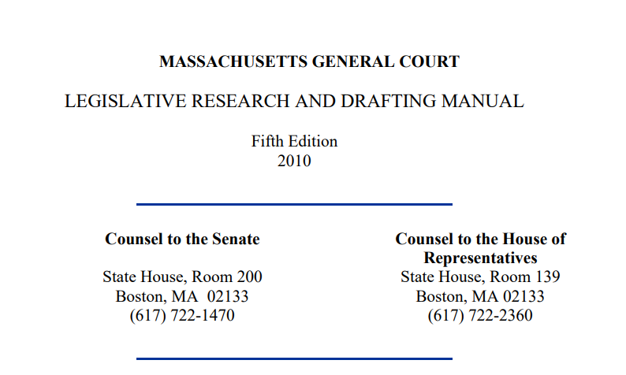
Step 2: Writing the bill
House and Senate Counsel
How to write a bill – 70 page manual!
Figure out precisely what you want to do
Idea
Draft
File
Cosponsorship
Hearing
Report
2nd Reading
3rd Reading (1)
3rd Reading (2)
1st Branch
2nd Branch
Concurrence
Enactment
Law

Slide 9
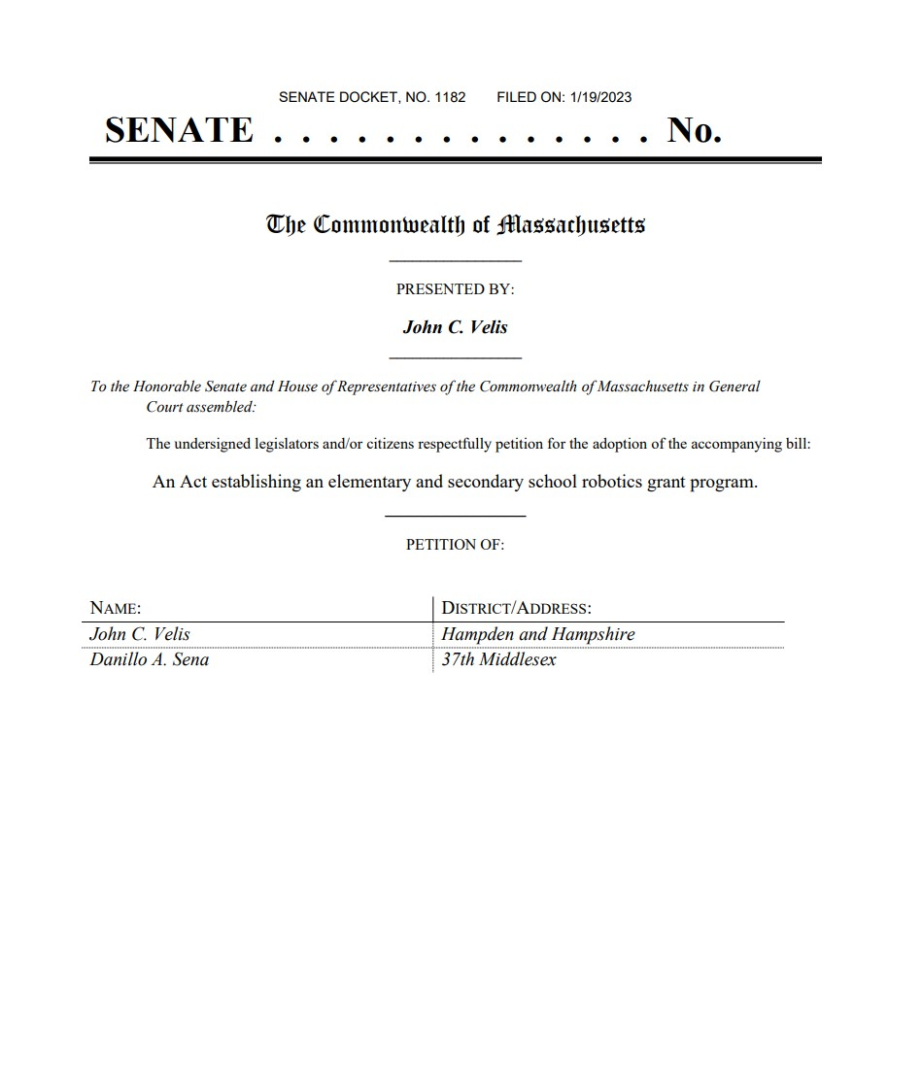
What does a bill look like?

Slide 10
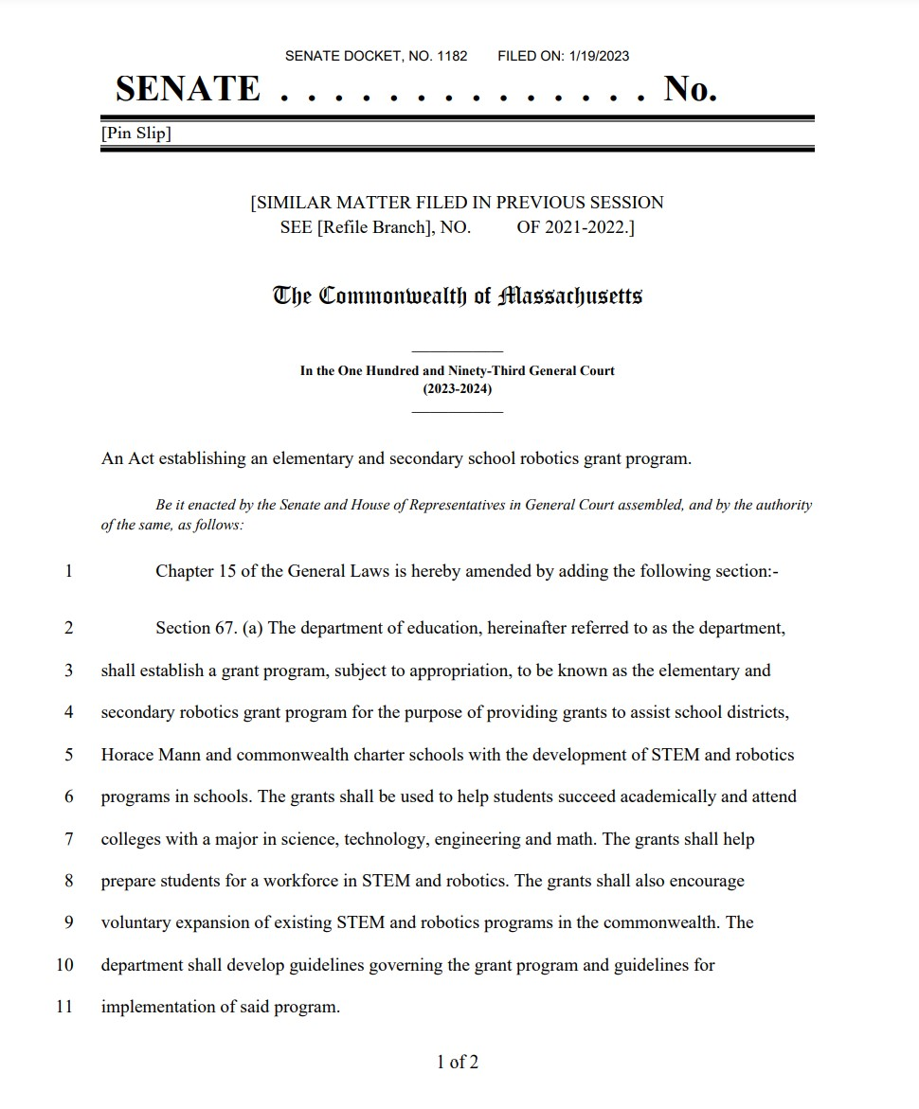
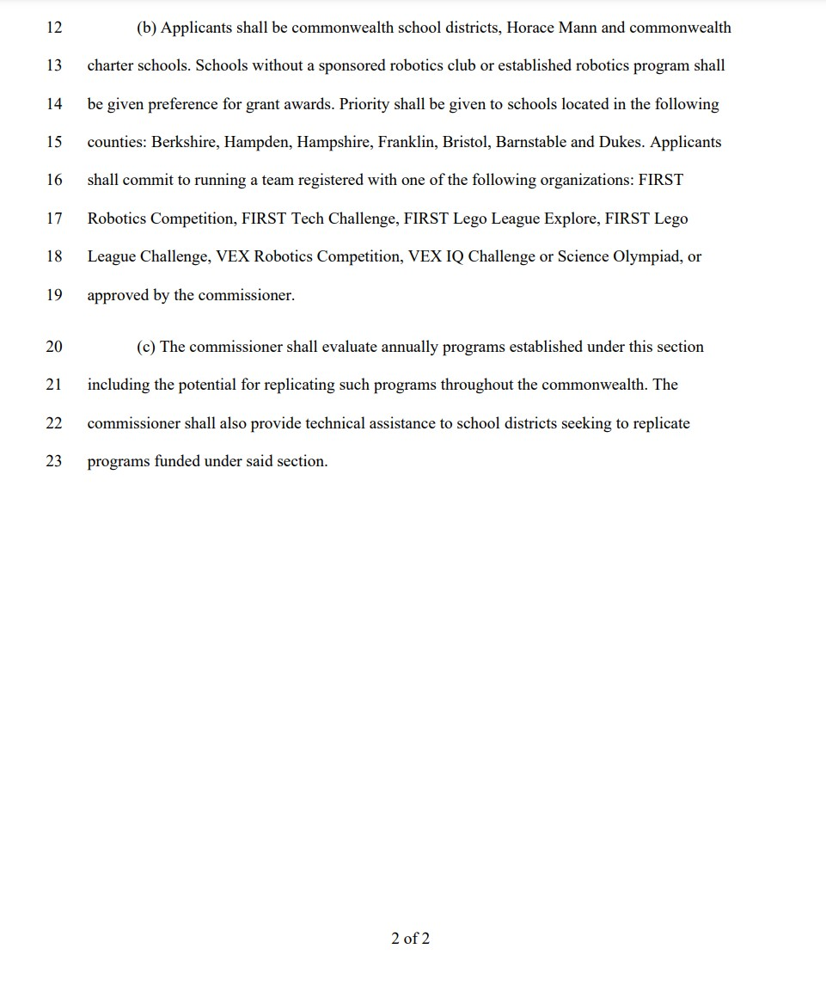

Slide 11
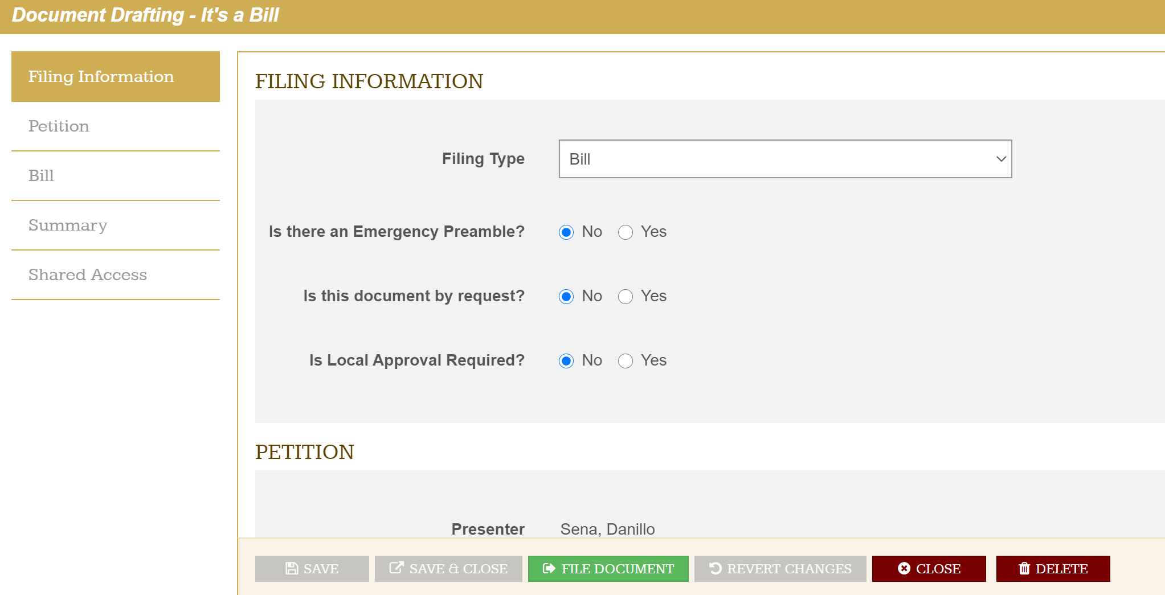
Step 3: Bill is filed
Whether proposed by a legislator, offered by the Governor or filed by a legislator at the request of a member of the public, a petition for legislation is filed in the House or Senate, accompanied by a bill that is assigned a number and referred to a committee.
Often, a Senator and a Representative will file the same bill in each of their chambers
Idea
Draft
File
Cosponsorship
Hearing
Report
2nd Reading
3rd Reading (1)
3rd Reading (2)
1st Branch
2nd Branch
Concurrence
Enactment
Law

Slide 12
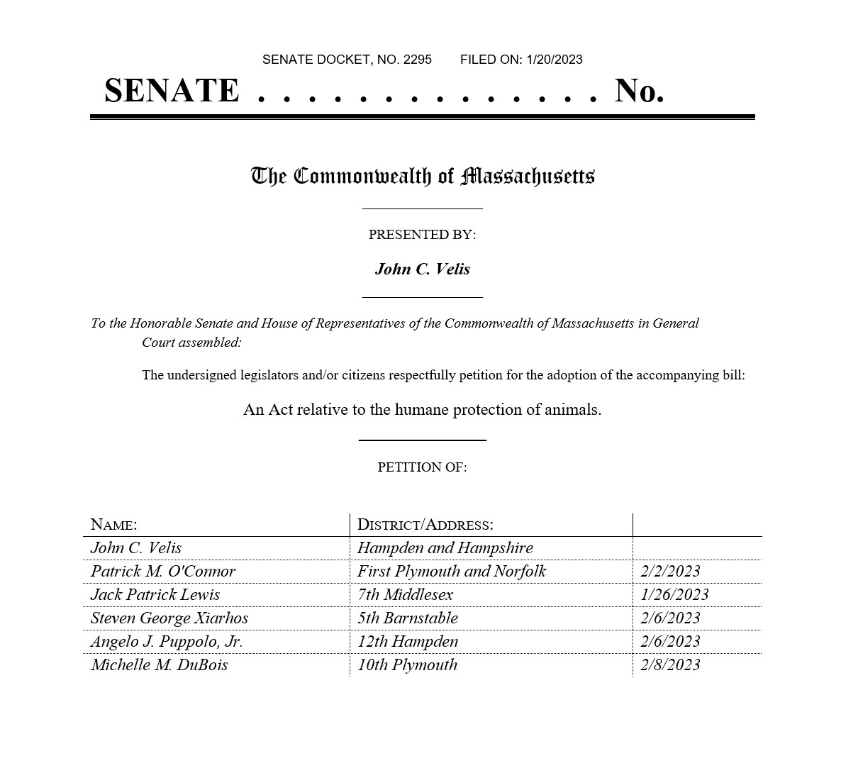
Step 4: Cosponsorship
Getting other legislators to sign on to show support
Idea
Draft
File
Cosponsorship
Hearing
Report
2nd Reading
3rd Reading (1)
3rd Reading (2)
1st Branch
2nd Branch
Concurrence
Enactment
Law

Slide 13
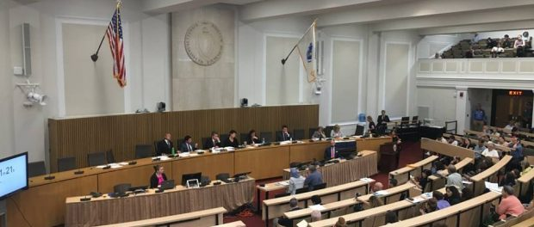
Step 5: Hearing and testimony
The bill is sent to a committee, which holds a public hearing
The committee hears testimony regarding the bill from the public, government officials and office holders.
After the hearing is held, the committee issues a report recommending whether the petition “ought to pass” (reported favorably), “ought not to pass” (reported adversely), be subject to further study or discharged to another committee.
Committee can also redraft bill and report it out
Idea
Draft
File
Cosponsorship
Hearing
Report
2nd Reading
3rd Reading (1)
3rd Reading (2)
1st Branch
2nd Branch
Concurrence
Enactment
Law

Slide 14
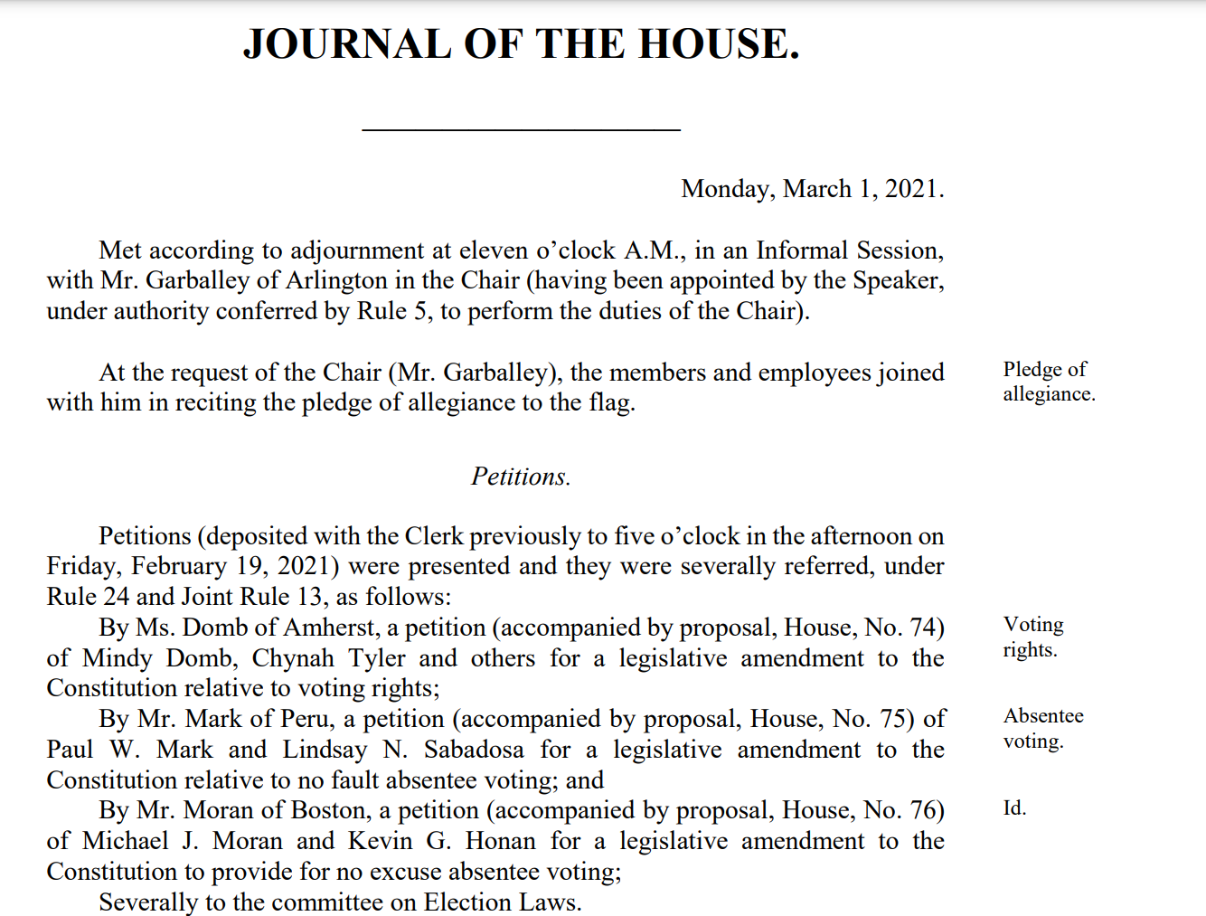
Step 6: Committee Report - Rejection or on to First Reading
A bill reported favorably appears in the Journal of the House or Senate and is given its first reading, usually followed by referral to another committee for further review.
A measure reported adversely will not proceed further unless the unfavorable report is overturned by a vote of either branch.
Idea
Draft
File
Cosponsorship
Hearing
Report
2nd Reading
3rd Reading (1)
3rd Reading (2)
1st Branch
2nd Branch
Concurrence
Enactment
Law

Slide 15
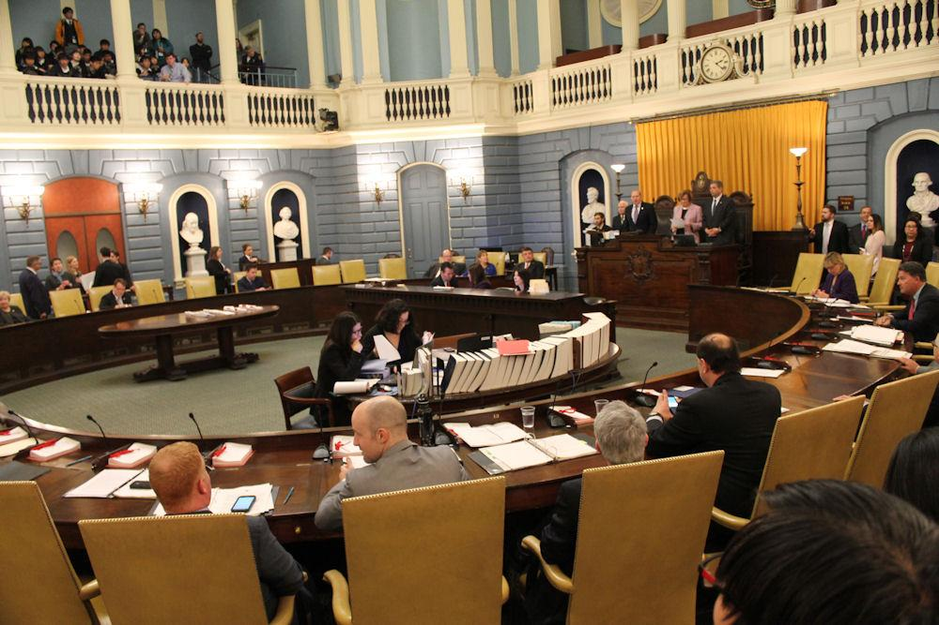
Step 7: Bill Read a Second Time, Debate Begins
Upon the second reading of a bill on the floor, it is subject to debate, motions and amendments.
Idea
Draft
File
Cosponsorship
Hearing
Report
2nd Reading
3rd Reading (1)
3rd Reading (2)
1st Branch
2nd Branch
Concurrence
Enactment
Law

Slide 16
Step 8: Bill Proceeds to the Committee on Bills in the Third Reading
The Committee on Bills in the Third Reading examines the bill for legality, constitutionality and the duplication or contradiction of existing law.
After a thorough review, the bill is released and heads back to the House or Senate floor for a third reading.
Idea
Draft
File
Cosponsorship
Hearing
Report
2nd Reading
3rd Reading (1)
3rd Reading (2)
1st Branch
2nd Branch
Concurrence
Enactment
Law

Slide 17
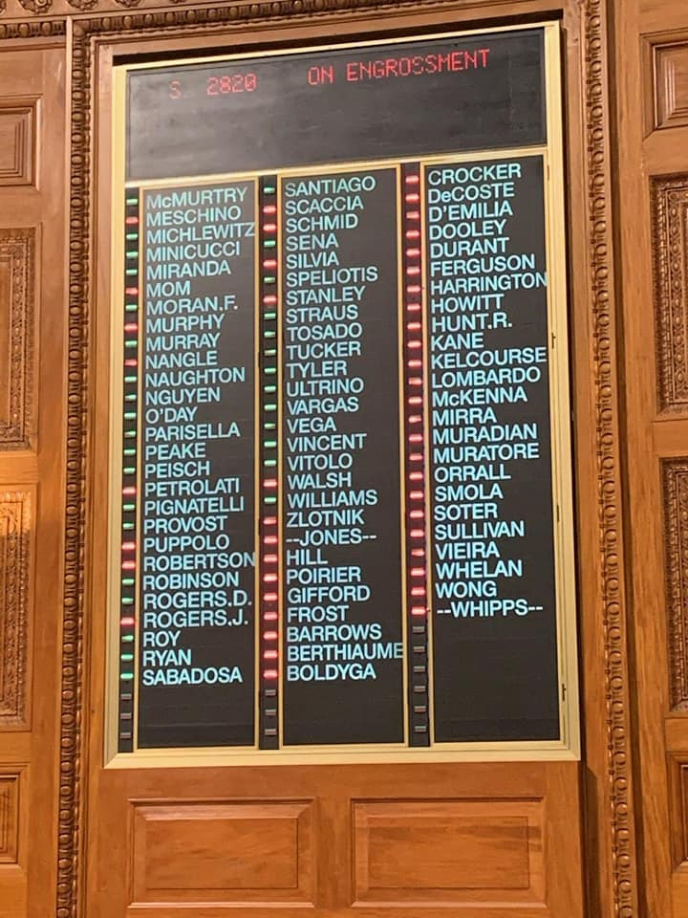
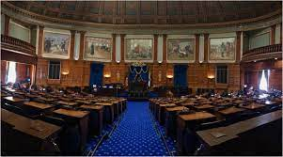
Step 9: Bill Read a Third Time, Floor Debate Continues
Upon the third reading of the bill, it is again subject to debate, motions and amendments in the House or Senate
Once debate concludes, a vote is taken on whether to pass the bill to be engrossed (passed)
Idea
Draft
File
Cosponsorship
Hearing
Report
2nd Reading
3rd Reading (1)
3rd Reading (2)
1st Branch
2nd Branch
Concurrence
Enactment
Law

Slide 18
Step 10: Bill Passed to be Engrossed by One Legislative Branch
Upon a favorable vote by the House or Senate, the bill advances to the other legislative branch.
Idea
Draft
File
Cosponsorship
Hearing
Report
2nd Reading
3rd Reading (1)
3rd Reading (2)
1st Branch
2nd Branch
Concurrence
Enactment
Law

Slide 19
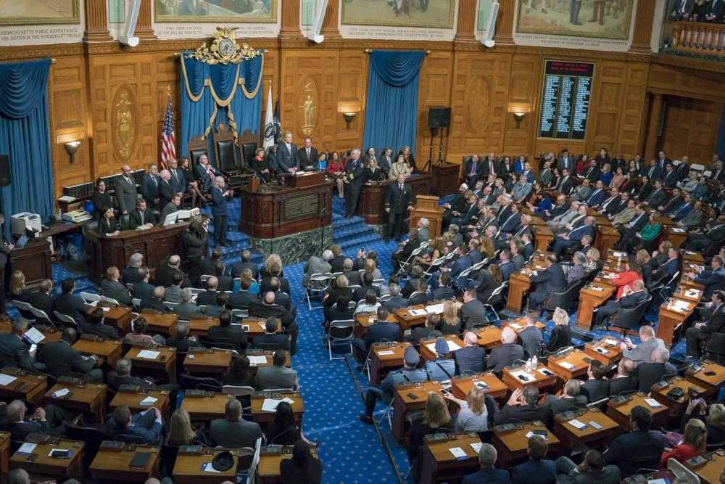
Step 11: Second Legislative Branch Considers the Bill
If the bill advances through three readings and is engrossed in the second legislative branch, it will be sent to the Legislative Engrossing Division to be typed on special parchment as required by law.
Idea
Draft
File
Cosponsorship
Hearing
Report
2nd Reading
3rd Reading (1)
3rd Reading (2)
1st Branch
2nd Branch
Concurrence
Enactment
Law

Slide 20
Step 11.5: Amendments Produce Conflicting Versions
If the bill is amended by the second branch, it will have to be returned to the first branch for a concurrence vote.
If concurrence is rejected, a bi-partisan conference committee of three members from each branch is appointed to craft a compromise bill that will be sent to both legislative branches for a final vote.
The conference committee’s report recommending the compromise bill is not subject to amendment, so the legislators need to vote ‘yes’ or ‘no’ on it.
Idea
Draft
File
Cosponsorship
Hearing
Report
2nd Reading
3rd Reading (1)
3rd Reading (2)
1st Branch
2nd Branch
Concurrence
Enactment
Law

Slide 21
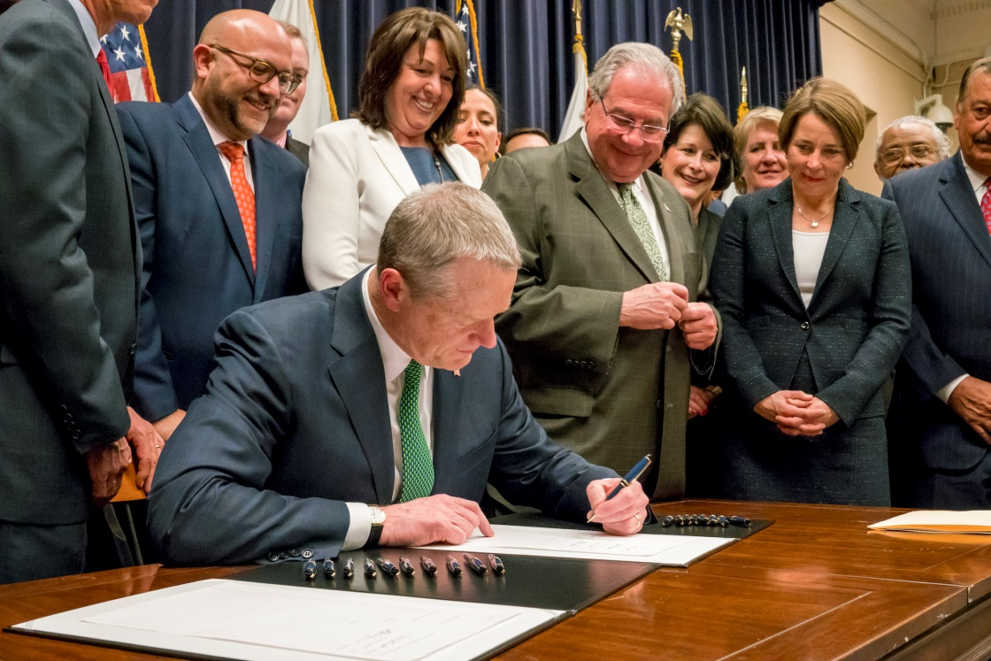
Step 12: Bill Enacted and Sent to the Governor
A vote to enact by both legislative branches results in passage of the bill, with the newly-created Act sent to the governor.
The governor has the authority to:
Sign the bill into law
Veto the legislation
Or send the bill back to the Legislature with recommended amendments.
A veto by the governor can be overridden with a two-thirds vote in both legislative branches.
Idea
Draft
File
Cosponsorship
Hearing
Report
2nd Reading
3rd Reading (1)
3rd Reading (2)
1st Branch
2nd Branch
Concurrence
Enactment
Law

Slide 22
Step 13: Original Idea Becomes Law!
The act, which began its journey through the legislative process as an idea, becomes law in Massachusetts if it is signed by the governor, or if a veto by the governor is overridden.
The new law usually takes effect in 90 days but can become effective immediately if it includes an emergency preamble.
A bill can also become effective later than 90 days if specified in the bill text.
Idea
Draft
File
Cosponsorship
Hearing
Report
2nd Reading
3rd Reading (1)
3rd Reading (2)
1st Branch
2nd Branch
Concurrence
Enactment
Law

Slide 23
Hooray, your bill is passed and is now law! Now, let’s take a brief recess.

Slide 24
Budget Process
July 1st is the beginning and end of the Fiscal Year.
Any appropriations or budget bills have to begin in the House of Representatives
So called “Money” or “Tax” Bills
Commonwealth must have a Budget based on State Revenue
Developed through House and Senate Ways and Means Committees
House Chair Aaron Michlewitz (D-Boston, 3rd Suffolk District)
Senate Chair Michael Rodrigues (D-Westport, 1st Bristol and Plymouth District)

Slide 25
The Budget: Governor & House
Early January: Governor’s budget released, providing recommendations from the executive for next year.
Late February and Early March: Ways and Means chairs meet with legislators to discuss their budget priorities
2nd Week of April: House Ways and Means (HWM) Budget Released
Prior to its release, HWM holds public hearings across the state
Input from Gov’s budget as well as from Administration on expected Tax Revenue for upcoming fiscal year
Last Week of April: House debate, providing an opportunity for House members to file amendments and debate
Following debate and a vote, the House budget is passed and sent on to the Senate
Governor (1)
HWM
Debate (1)
House
SWM
Debate (2)
Senate
Conference
Final
Governor (2)
Enactment

Slide 26
The Budget: Senate
2nd Week of May: Senate Ways and Means (SWM) budget released
Formulated separately from House and Gov’s budget
Developed after public SWM hearings
3rd Week of May: Senate debate, including amendment filing
Senators vote on a budget following debate
Governor (1)
HWM
Debate (1)
House
SWM
Debate (2)
Senate
Conference
Final
Governor (2)
Enactment

Slide 27
The Budget: Conference Committee
Conference Committee Formed
Committee is appointed of 4 members from each body to reconcile differences in bill
Committee normally consists of leadership, Ways and Means members and members of the minority party
Final Budget
After conference committee finishes budget compromise is approved by both bodies and sent to the Governor’s desk
Governor (1)
HWM
Debate (1)
House
SWM
Debate (2)
Senate
Conference
Final
Governor (2)
Enactment

Slide 28
The Budget – Governor & Enactment
Governor Actions
Governor has 7 days to approve budget or to provide vetoes and return budget to the legislature
Line Item Vetoes
Veto Override
If Governor sends back vetoes, the legislature has ability to override these vetoes with a 2/3 majority vote
Budget Enacted
Revenue changes? Additional supplemental budgets can be filed
Governor (1)
HWM
Debate (1)
House
SWM
Debate (2)
Senate
Conference
Final
Governor (2)
Enactment

Slide 29
What does a legislator actually do?
Session
Committee
Advocacy Organization Meetings
Briefings & Advocacy Events
Local Events
Caucuses
Constituent Meetings
Constituent Services

Slide 30
Constituent Services
Unemployment (DUA/PUA)
RMV
Evictions
Immigration
Letters Of Support
Local and state organization referrals (ex. Household Goods, RCAP, Veterans Inc.)
Connection with federal and local officials

Slide 31
Effective Advocacy
Attend Public Hearings
Get involved with like-minded groups to bring attention to an issue (Google ‘issue + town/region/state’)
Reach out to your legislators in the House and Senate
Letters
Emails
Phone Calls
Meetings with legislators

Slide 32
Questions?

Slide 33
Contact Information
617-722-1415
gabe.adams-keane@masenate.gov
24 Beacon St, Rm 519 Boston, MA 02133

